Slide 1
Measuring Employment Protection: The State of the Art
Mariya Aleksynska
International Labour Organization

Slide 2
Introduction
Growing interest from policymakers in labour market institutions in the past decades, but particularly so with the advent of the Great economic recession
unemployment: over 25% in Spain and Greece, 16% in Portugal
youth unemployment: over 50% in Spain and Greece, and nearly 40% in Portugal in 2015
stagnating and declining labour income shares
widening inequality
Do labour market institutions play a role?

Slide 3
Outline
1. What do we mean by labour market institutions (LMI) in general and by employment protection (EPL) in particular?
What is the role of EPL for economic outcomes?
2. How can LMI and EPL be measured?
3. What is missing from the debate?
4. Experiments with reforms

Slide 4
1. What is meant by labour market institutions?
the set of laws, regulations, norms, conventions, and processes that result from collective choice and provide a framework for individual choices over labour supply, demand, and pay

Slide 5
1. What is meant by labour market institutions?
Social security
Employ-ment relation-ship
Unemp-loyment benefits
Labour taxes
ALMP
EPL (contract termina-tion)
Labour cont-racts
Working time
OSH
Wages
labour laws and regulations in the areas such as
processes that implement them, including enforcement mechanisms and collective bargaining

Slide 6
1. What is meant by labour market institutions?
Social security
Employ-ment relation-ship
Unemp-loyment benefits
Labour taxes
ALMP
EPL (contract termina-tion)
Labour cont-racts
Working time
OSH
Wages
labour laws and regulations in the areas such as
processes that implement them, including enforcement mechanisms and collective bargaining

Slide 7
Expected impacts? Example of EPL
One of the most controversial labour market institutions
Theory: costs of firing modify incentives to hire. Thus, EPL affects employment flows, while stocks are “relatively” unchanged
Empirics: over two hundred studies to date, showing negligible aggregate effects in both directions (if any), depending on the set-up. Certain consensus: groups at the “margins” of the labour market are affected the most.
Notes:
Employment protection law (EPL) is adopted to show theoretical and empirical issues with the G20 reform agenda
Empirics: OECD GFG literature reviews are actually quite balanced in presenting various evidence. However, for the G20MOD, only the evidence on the negative impacts of EPL is retained. This is surprising, because, despite the mixed evidence, there ARE certain consensus views on this topic across academia and international organizations.

Slide 8
EPL: Some of the most recent “consensus” views on employment effects
The World Bank and the ILO agree on the existence of the “plateau” effects: the relationships between strictness of EPL and aggregate employment is non-linear
Source: Cazes et al., 2012; World Bank, 2013
The debate about the role of these institutions should not be focused on “less regulation versus more regulation” but on “what level of regulation would maximize employment”
Notes:
The negative impact of EPL is observed only when its strictness is very high (2/3 of G-20 countries lie below the EPL score of 2,6).
Hence, the debate about the role of these institutions should not be focused on “less regulation versus more regulation” but on “what level of regulation would maximize employment”

Slide 9
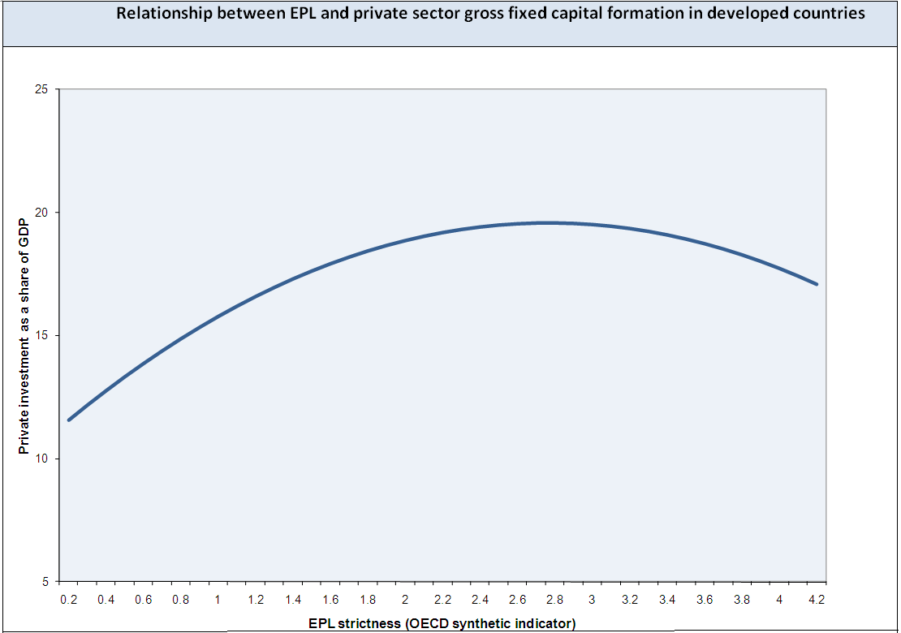
EPL: Some of the most recent “consensus” views on
income and productivity effects
ILO research also shows a non-linear relationship between EPL and private business investment: only particularly strict regulations have negative effect; in all other cases the relationship is null or slightly positive.
IMF (WEO, 2015) also shows that “labor market regulation is not found to have statistically significant effects on total factor productivity”, in an analysis based on 16 G-20 countries.
Source: Cazes et al., 2012
Notes:
NB: IMF (WEO, 2015) measures labor market regulation with the OECD EPL indicator

Slide 10
Despite certain consensus on the role of institutions, controversies remain
Part of the problem: DATA
Politically “easy” reforms, or lack thereof

Slide 11
2. Measuring LMI, and EPL in particular
Institutional efforts
OECD Summary Indicators of Strictness of Employment Protection Legislation
World Bank Employing Workers Indicators
ILO EPLex indicators
Think-tanks efforts
World Economic Forum, Labor Market Efficiency (LME)
IMD Government Efficiency (Labour regulations) Index
Fraser Institute Labor Market Regulations
Heritage Foundation Labor Freedom Index
Academia-led efforts
Labour Regulation Index, Cambridge Center for Business Research, Deakin, Lele and Siems
LAMRIG index by Campos and Nugent (2012)
1970-2006, 30+ countries 1990-nowadays, 117 countries
1950-2010,
140 countries
2004-2013, 144 countries
1995-2012, 59 countries
2002-2013, 58-144 countries
2006-2013, 180 countries
1985-2013, 44 countries
2006-2014, 180 countries
2009-2013, 100 countries
Other:
European Commission Labour Market Reform Database (LABREF)
FRDB-IZA Social Reforms Database

Slide 12
2. Measuring LMI, and EPL in particular
Institutional efforts
OECD Summary Indicators of Strictness of Employment Protection Legislation
World Bank Employing Workers Indicators
ILO EPLex indicators
Think-tanks efforts
World Economic Forum, Labor Market Efficiency (LME)
IMD Government Efficiency (Labour regulations) Index
Fraser Institute Labor Market Regulations
Heritage Foundation Labor Freedom Index
Academia-led efforts
Labour Regulation Index, Cambridge Center for Business Research, Deakin, Lele and Siems
LAMRIG index by Campos and Nugent (2012)
Labour-employer relations, wage determination, EPL laws and practice, management role, brain drain, female participation
Some EPL, MW,
unemployment legislation, immigration laws
Some EPL, MW CB, working time, conscription
Some EPL aspects, min. wages, working time
Contracts, working time, EPL, represent-tation, industrial action,
Some EPL aspects, min. wages, working time
EPL
Some EPL aspects, min. wages, working time
EPL
Other:
European Commission Labour Market Reform Database (LABREF)
FRDB-IZA Social Reforms Database

Slide 13
How do Indicators Compare? Correlations between selected labour market indicators and
total unemployment rate, 2009
Source: Aleksynska and Cazes, 2016

Slide 14
2. Measuring LMI, and EPL in particular
Institutional efforts
OECD Summary Indicators of Strictness of Employment Protection Legislation
World Bank Employing Workers Indicators
ILO EPLex indicators
Think-tanks efforts
World Economic Forum, Labor Market Efficiency (LME)
IMD Government Efficiency (Labour regulations) Index
Fraser Institute Labor Market Regulations
Heritage Foundation Labor Freedom Index
Academia-led efforts
Labour Regulation Index, Cambridge Center for Business Research, Deakin, Lele and Siems
LAMRIG index by Campos and Nugent (2012)
Other:
European Commission Labour Market Reform Database (LABREF)
FRDB-IZA Social Reforms Database

Slide 15
2.1 Common Challenges
Dimensions of composite indicators: the right choice of components
completeness and comprehensiveness versus overlaps
sound theoretical framework should be preferred
Data sources
legal data (case law vs other legal traditions; enforcement; coverage)
statistics
opinion surveys (representativeness, business cycle dependence)
Subjective / Ideological biases
challenges in interpreting labour law
more regulation does not always mean more protection …
choosing the right scale and assigning numeric coding (creating ordinal vs interval data)
Aggregation schemes
weights based on theoretical assumptions
equal weights to each dimension
weights according to their statistical significance

Slide 16
ILO EPLex contribution EPLex indicators in the Area of Terminating Regular Contracts (Individual Dismissals)
Based on the ILO Standards. Coding choices guided by the fundamental principles and rights at work; specific Standards regulating employment termination (C158; R166), and the outcomes of the 79th Session of the Committee of Experts on the Application of Conventions and Recommendations.
Based on the review of legislations in over 100 countries
Based on the overview of existing methodologies and their critiques; collaboration effort of economists and lawyers
Source: ILO, 2015a

Slide 17
3. What is Missing from the Debate? - 1
Social security
Employ-ment relation-ship
Unemp-loyment benefits
Labour taxes
ALMP
EPL (contract termina-tion)
Labour cont-racts
Working time
OSH
Wages
Recognition of a panoply of institutions; avoiding fragmented approach

Slide 18
3. What is Missing from the Debate? -2
Level
Coverage
Compliance
Notes:
However, levels of protection afforded by this institution are only part of the story. If we want to understand the effectiveness and the relevance of an institution, we also need to look at its coverage (i.e. how many workers are concerned), and compliance with it. While this statement is quite obvious, neither coverage nor compliance with institutions and regulations are usually taken into consideration in the economic modelling, or in forecasting the effects of reforms. Moreover, because of the lack of measures and of data on these two aspects of institutions, we still know little about the actual relevance of taking coverage and compliance into account. The ILO has recently embarked on a new research agenda collecting data on coverage and enforcement of labour market institutions around the world. In what follows, I will present you the most recent figures shedding light on these issues.

Slide 19
Example of Minimum Wage coverage
Source: Belser and Rani, 2015, in Berg, 2015

Slide 20
Estimated rate of compliance with minimum wage legislation in selected developing economies
Source: Belser and Rani, 2015, in Berg, 2015

Slide 21
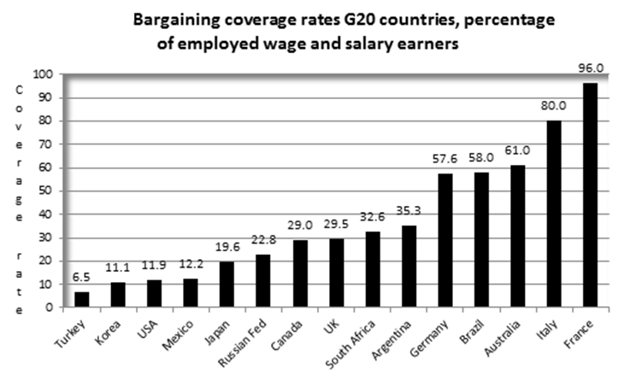
Example of Collective Bargaining Coverage
Source: ILO, 2015b

Slide 22
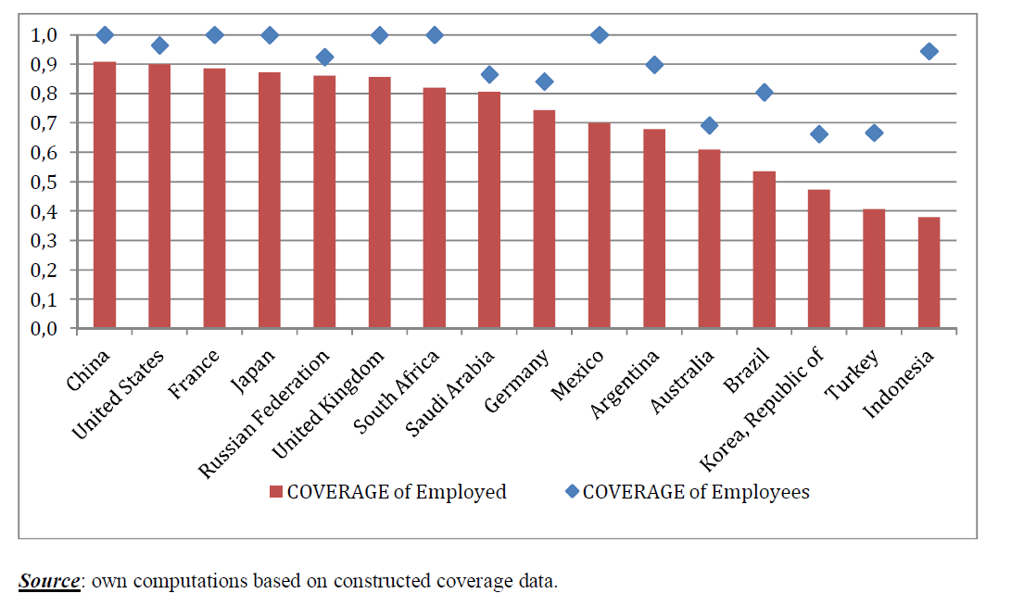
What about EPL?
EPL Coverage
Source: Aleksynska and Eberlein, 2016

Slide 23
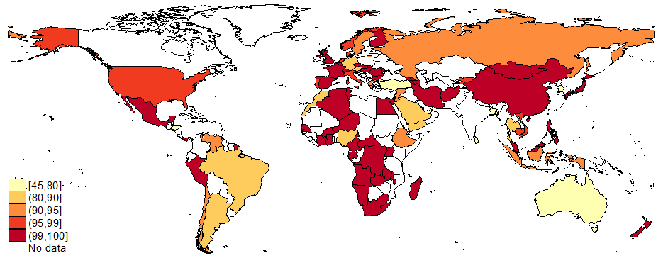
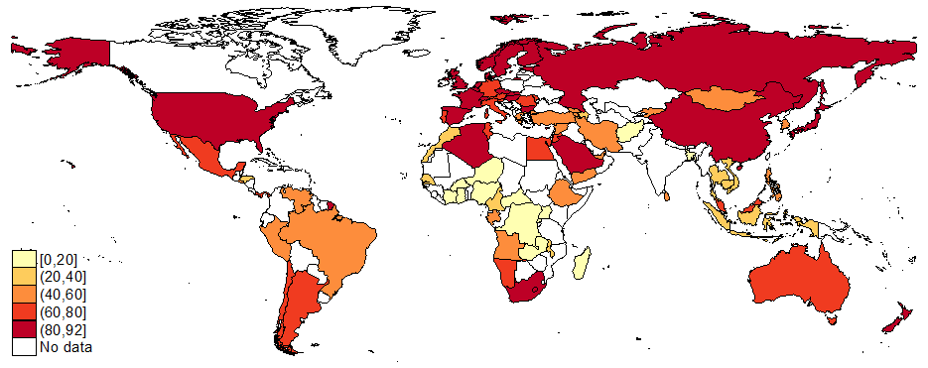
EPL Coverage of Employees
EPL Coverage of Employed
Source: Aleksynska and Eberlein, 2016

Slide 24
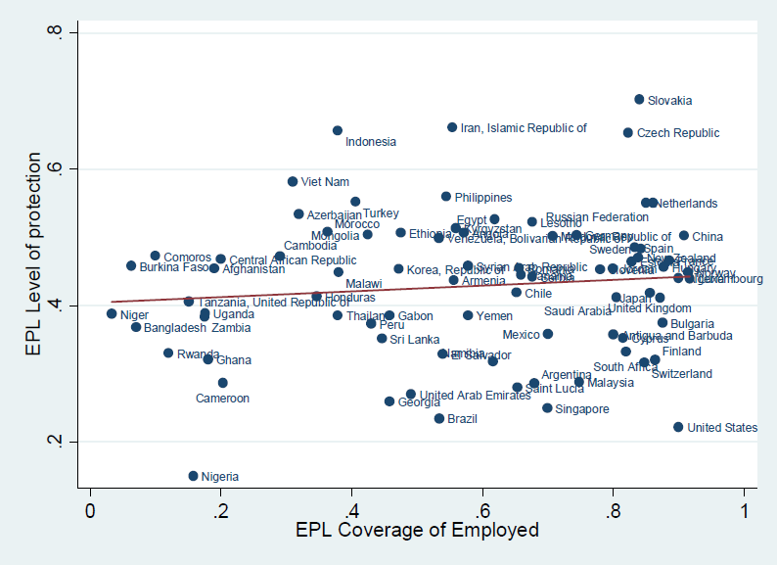
EPL Level and Coverage: Are there Trade-Offs?
Source: Aleksynska and Eberlein, 2016

Slide 25
4. Experiments with EPL reforms
Reducing protection for permanent workers
Allowing an easier use of temporary contracts
Allowing to use fixed-term contract without an objective reason (for permanent tasks)
Allowing for additional renewals / extended duration
Introducing new types of contracts (project-based)
Tolerating grey areas and creating new forms of employment relationship (parasuboridnate)

Slide 26
4. Experiments with EPL reforms - consequences
Spread of non-standard employment
As other complementary reforms do not follow (at least not immediately), this creates important work deficits

Slide 27
Temporary workers, as a percentage of wage employees, selected countries, 2000-14
Source: ILO, 2016

Slide 28
Source: ILO, 2016

Slide 29
Instead of a Conclusion - 1
More efforts are still needed to create sound indicators of labour market regulations, EPL being among them
Legal indicators must be complemented by indicators of:
Legal coverage and enforcement / compliance
Quality, not just quantity, of institutions
their adequateness
degree of compliance with fundamental principles of civil rights and minimum international standards
awareness among workers
enforcement and enforceability
efficiency of the court system; transparency and predictability of redress procedures
relevance in presence of large informal economies

Slide 30
Instead of a Conclusion - 2
The need of certain reforms in certain countries is not denied. But it is important to ask the “right” questions:
How to improve the relevance of the institutions, rather than focus uniquely the level of protection that they offer?
Rethinking institutions: shifting the debate from levels of regulations to a reform strategy that can improve the functioning of institutions and of labour markets
Avoiding experiments with reforms based on shaky empirical evidence
Avoiding partial reforms and fragmented approach to labour markets
Aggregate indicators may serve as a useful comparative tool, but for specific reforms of labour markets, country-specific tailored approach is needed, taking into account the complexity of the institutional system, with reference to ILS
Remembering that labour market institutions should serve the role of correcting market failures: avoid creating legislation that adds room for new market failures

Slide 31
Thank you!
aleksynska@ilo.org

Slide 32
References:
Aleksynska, M., and S. Cazes, 2016. Composite Indicators of Labour Market Regulations in a Comparative Perspective. IZA Journal of Labor Economics, 2016, Vol. 5(3). DOI: 10.1186/s40172-016-0043-y.
Aleksynska, M., and F. Eberlein, 2016. Coverage of Employment Protection Legislation. IZA Journal of Labor Policy, 2016. DOI: 10.1186/s40173-016-0073-x. Belser, P., U. Rani, 2015. Minimum Wages and Inequality. In Berg, J. (Ed), Labour Markets, Institutions and Inequality. Edward Elgar, ILO: Geneva.
Cazes, S., S. Khatiwada,, M. Malo, 2012. Employment Protection and Collective Bargaining: Beyond the Deregulation Agenda, ILO Employment Working Paper No. 133.
IMF, 2015. World Economic Outlook. Uneven Growth: Short- and Long-Term Factors. IMF: Washington.
ILO, 2015a. Employment Protection Legislation Summary Indicators in the Area of Terminating Regular Contracts (Individual Dismissals). ILO: Geneva.
ILO, 2015b. Database on Collective Bargaining Coverage. ILO: Geneva.
ILO, 2016 (forthcoming). Non-standard Employment Around the World: Understanding Challenges, Shaping Prospects. ILO: Geneva.
World Bank, 2013. The World Development Report 2013: Jobs. WB, Washington, DC.

