Slide 1
Beyond dualisms – towards more flexicure labor markets? Werner Eichhorst FES and HSE Conference on “LABOUR LEGISLATION AND ITS ROLE IN THE CONTEMPORARY ECONOMY” Moscow, 3 November 2016

Slide 2
Dual labor markets in Europe
Segmentation via different types of employment protection has been a typical patterns of institutional change in European countries since the 1980s („flexibility at the margin“) – linked also to unequal access to unemployment benefits and active labor market policy measures -> secure vs. insecure jobs
Fixed-term employees and young people have to bear a disproportionate share of employment adjustment during and after the crisis, and solo self-employment tends to become widespread in some age groups and occupations
Crisis has increased political and economic problem pressure to modify existing institutional arrangements – in a more ‚inclusive‘ or ‚flexicure dimension‘?

Slide 3
Share of temporary employment in dependent employment
Source: OECD Data.

Slide 4
Year-to-year transition from temporary to permanent contracts
Source: Eurostat, ELFS, EU-SILC (ESDE 2016).

Slide 5
Reforming employment protection
Liberalizing dismissal protection and/or de/re-regulating temporary contracts?
After the crisis, some countries with strong EPL for permanent workers have reduced/clarified dismissal protection more strongly than in earlier phases, ofthe combined with mechisms favoring internal and wage flexibility (e.g. Portugal, Spain, Italy, Greece, Slovenia, France)
Trend in EPL for temporary contracts is less clear – some re-regulation, but certain tendency to make short-term contracts more costly to employers, e.g. higher UI contibutions in Slovenia, France, Italy, with incentives to convert into permanent jobs, or extra severance pay for temporary workers (Spain, France)

Slide 6
Changes in employment protection legislation, 2008 to 2013
Source: OECD EPL indicator.

Slide 7
Temporary and permanent hirings in selected countries over time, 2003-2013
Source: Labor Force Survey 2003-2014, own calculations (weighted). Shares of temporary and permanent employment among new hires in each year.

Slide 8
Assessment
No significant change in long-standing trends in permanent vs. temporary hirings
Some most recent reforms, e.g. Italian ‚Jobs Act‘, are not yet covered in comparative data, but preliminary evidence shows some effect (combined with subsidization)
Cyclical effects seem to dominate (at least for the time being)

Slide 9
Solo-self employment
Outside traditional employment and social protection in many countries, in particulary at odds with Bismarckian model
Freelance as an alternative to ‚precarious‘ dependent employment, sometimes encouraged by policy makers (‚co.co.co‘ in Italy, ‚auto-entrepreneurs‘ in France)
Potentially becoming more widespread with the rise of the ‚gig economy‘ or ‚platform economy‘ with quick and easy outsourcing and matching between suppliers and customers, but so far no major rise in gig type of activities based on regular surveys
This is possibly due to problems of measurement:
Crowd working is either a second (side) job, that is not properly stated
Or crowd working platforms are used by fulltime self-employed additionally to traditional (offline) sources in order to acquire clients
Current evidence is based on small-scale surveys only

Slide 10
Freelance employment outside agriculture in the EU, as % of total employment
Source: EU LFS, own calculations.

Slide 11
The social structure of crowd workers in Germany
Number of cases: 248 persons with
German citizenship,
living in Germany
Average age: 35,5 years
56,5% male, 43,5% female; 53,3% single (unmarried)
54,6% with higher education entrance qualification
51,4% with completed vocational training or university degree
37,9% freelancing or self-employed, 27,9% employees (in other jobs)
Active as a crowd worker average since 15 months on average
About one half is willing to change to regular (dependent) employment with similar tasks.
Crowd working net income: 50% below 200 €, average net income as side job: 326 €, as main job: 1 504 €
Average net income of crowd workers (excl crowd work): 1 082,50 €.
Source: Leimeister, J. M., D. Durward, S. Zogaj (2016)

Slide 12
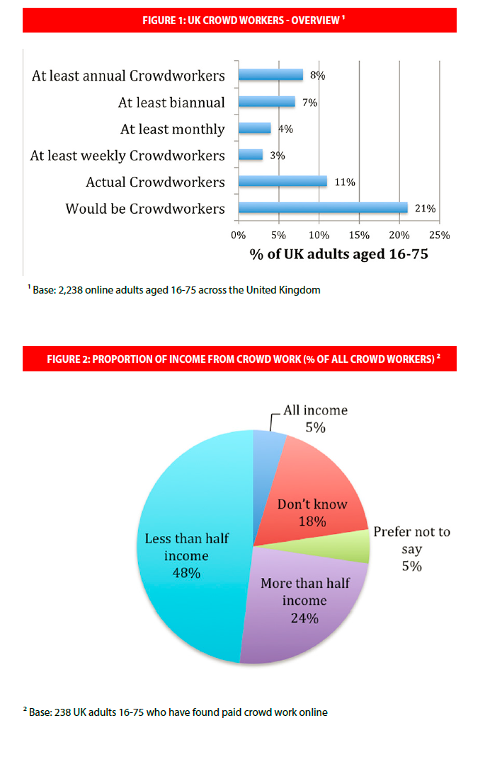
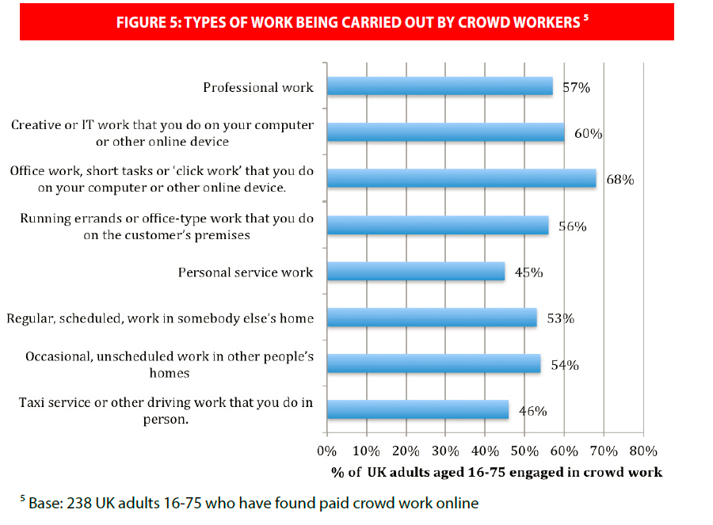
Crowd working in the UK
Online survey in the UK (2,200 + respondents)
About 11% have actually worked with online platforms of different character
Mostly secondary income, but main source for one third; concerning family income, crowd workers are mostly the main breadwinners
Diverse types of tasks
More women then men, mostly young
Source: Huws/Joyce (2016)

Slide 13
Unemployment benefits
In some countries, despite an austerity situation, access to unemployment benefits was improved for people with short employment spells
Examples: Reforms in Italy regarding more universal and more easily accessible UI benefits for those with short employment spells and project collaborator status (ASPI, Mini-ASPI and NASPI, DIS-COLL); similar initiative in France and Spain
Some increase in benefit coverage in those countries (but not in others)

Slide 14
Share of short-term unemployed receiving benefits
Source: DG EMPL, ELFS (ESDE 2016).

Slide 15
ALMPs
ALMPs can shorten unemployment and increse hiring probabilities, thereby make a flexible labor market with high turnover more acceptable
Training and hiring incentives can be particularly effective in stimulating mobility
ALMPs are costly, they require substantial funding, proper (selective) targeting and effective delivery agencies
Many countries have moved in the direction of stronger activation, some also with increased spending and modernizing the public employment service – but in times of austerity
Countries with high unemployment could not increase spending in line with caseloads

Slide 16
ALMP spending on training per person looking for work, 2007 and 2013
Source: Eurostat LMP database (ESDE 2016).

Slide 17
Spending on PES per person looking for work, 2007 and 2013
Source: Eurostat LMP database (ESDE 2016).

Slide 18
Policy issues (I)
Recent reforms have only partially made labor markets more ‚flexicure‘ – here, the EU social pillar could call for credible standards regarding
Quality of jobs, including access to social protection, with no/less distinction by type of job
Easing transition to other types of employment
Moderate re-regulation of fixed-term contracts while easing dismissal protection is still a plausible approach
Further easing of transitions from temporary jobs to permanent ones via more training during fixed-term contract spells
Incentives for employers to internalize costs of short-term employment and encourage permanent hirings (bonus/malus)

Slide 19
Policy issues (II)
Competition between (traditional) employers with regular workers and platforms using formally self-employed might become an issue – as platforms tend to reject responsiblity as an employer
Legal issue of defining dependent employment vs. self-employment
More universal social insurance (UI/ALMP, pensions, health) would make definitional issues regarding („bogus“) self-employment or „independent workers“ (Harris and Krueger) less critical
Potential (partial) opt-out if there is adequate alternative social protection, in particular old-age pension coverage, either private or via professional associations

Slide 20
Policy issues (III)
Funding issues:
Contributions from crowdworkers and platforms or users/contractors (as quasi employers) → see German artists‘ social insurance
Actual taxation of second jobs / side activities as part of total income – with/without threshold values
International/non-European platforms → tax on transactions that have some relation with the EU
A European framework of rules for solo self-employment and related rights could be a timely issue

Slide 21
Research issues
Assessing the impact of EPL and UB/ALMP reforms in short/medium and long run; unexpected side effects?
Designing optimum EPL given path dependencies, political economy constraints?
Better measurement of the extent and quality of new types of work, including combinations and sequences of jobs, secondary activities, freelance/crowdworking

Slide 22
Werner Eichhorst
IZA, P.O. Box 7240,
53072 Bonn, Germany
Phone: +49 (0) 228 - 38 94 531
Fax: +49 (0) 228 - 38 94 180
E-mail: eichhorst@iza.org
www.iza.org

