Slide 1
Introduction to the economics of law: the case of labour law
Simon Deakin
University of Cambridge (s.deakin@cbr.cam.ac.uk)
Presentation to the Higher School of Economics, Moscow,
3 November 2016

Slide 2
Policy perspectives
ILO standards on freedom of association and collective bargaining have been at the foundation of international labour code, from the Declaration of Philadelphia (1944) to the ILO Declaration of Fundamental Principle and Rights at Work (1998) and the Decent Work agenda
By contrast, the IMF and World Bank have been sceptical of the economic effects of labour laws : ‘Laws created to protect workers often hurt them’ (World Bank, Doing Business report, 2008)
Although in its 2014 and 2015 Doing Business reports the World Bank changed its view, arguing that there can be too little regulation as well as too much

Slide 3
Labour law and economic theory
Neoclassical theory: labour law as an ‘interference’ with the market, distorting the workings of the price mechanism and causing involuntary unemployment (Stigler)
Unions as ‘cartels’ (Posner)
Labour law as raising the ‘natural’ (non-inflationary) rate of unemployment (Friedman)

Slide 4
New-institutional approaches
‘Imperfections’ in labour markets justify legal regulation
Employer monopsony (Manning)
Asymmetric information (Stiglitz)
Signalling (Spence, Akerlof)
Limitations: not clear what the hypothetically ‘optimum’ level of regulation would be

Slide 5
Systemic approaches
Labour law rules as evolved solutions to coordination problems
Endogenous labour law
Imperfect regulation
Selective impact of legislative interventions
Indeterminacy of outcomes?

Slide 6
The structure of the employment contract
Subordination: the employer’s power to coordinate work (‘managerial prerogative’)
The restrictive ‘service model’ as the origin of the duty of obedience; gradually this was limited by ‘contractualisation’
Protection: employment used to channel and collectivise social risks arising from work: social security, taxation, occupational welfare
The ‘cornerstone’: the employment contract supported the business enterprise, and the social or welfare state

Slide 7
Labour law and the theory of the firm
Authority relation means employer can dispense with the need to renegotiate ex post the terms of employment contract (Coase)
Team production: monitoring and measurement problems lead to emergence of manager/owner as residual claimant (Alchian and Demsetz)
Property rights: property rights over non-human assets gives employer right to adjust competing claims of stakeholders (Hart)

Slide 8
Empirical advances: new findings
Positive wage and employment effects of minimum wage legislation revealed in comparative ‘before and after’ studies (‘difference-in-differences techniques): Card and Krueger (but cf. later critique: Neumark and Wascher).
UK national minimum wage reintroduced after 1998 without significant disemployment effects, in part because of impacts on profits and productivity (Metcalf)
Discriminating studies of sectoral impacts of employment protection law and work-life balance laws find evidence of positive productivity effects (Bassanini and Venn)
Positive relationship between EPL and innovation (Acharya et al.)
Experimental studies support case for ‘fairness norms’ in the contract of employment (Bartling, Fehr and Schmidt)

Slide 9
An experimental study: Bartling et al. (2012)
Test for the effects of (i) reputation and (ii) fairness norms on the prevalence of sales vs. employment contracts
Employment contract generates rent from cooperation, but risk, for worker, of employer moral hazard
Two experiments: RANDOM (players swap roles, one-shot game, no learning) and FIXED (players’ roles are fixed, repeat play, learning)
Employment contracts 40% in RANDOM, 80% in FIXED

Slide 10
Reputation and fairness norms
‘Viable authority relationships under employment contracts thus arise endogenously as the dominant mode of governance only when both principals’ fairness preferences and reputation building mechanisms are present… We are able to identify the conditions under which employers are likely to abuse their authority… To the extent to which reputational forces alone are insufficient for solving the employers’ moral hazard problem, labor unions and labor legislation can play an efficiency enhancing role by constraining the employers’ ability to assign the workers inefficient tasks’ (Bartling et al., 2012)

Slide 11
The CBR Labour Regulation Index
117 countries, 44 years (1970-2013)
40 indicators
5 sub-indices: different forms of employment, working time, dismissal, employee representation, industrial action
Dataset publicly available for downloading and use:
Adams, Z., Bishop, L. and Deakin, S. (2016) ‘CBR Labour Regulation Index (Dataset of 117 Countries)’, in J. Armour, S. Deakin and M. Siems (eds.) CBR Leximetric Datasets http://dx.doi.org/10.17863/CAM.506 (Cambridge: University of Cambridge Data Repository).

Slide 12
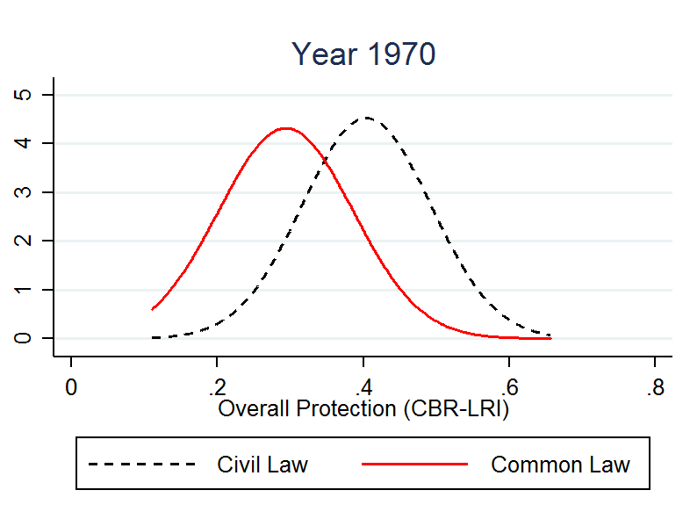
Trends by legal origin

Slide 13
Selected OECD countries vs. selected BRICS

Slide 14
Use in econometric analysis
No presumption for or against a particular theory of labour law’s impact on the economy
Suitable for panel data and time series analysis
Should be used in conjunction with other institutional datasets (e.g. World Bank, Freedom House data on ‘rule of law’
‘Cambridge equation’ (pooled mean group regression model) most appropriate for dynamic panel data analysis capable of distinguishing between short-run and long-run effects of labour regulation (Pesaran, Shin and Smith)

Slide 15
Econometric results
Increases in DFE and EPL correlated with higher rate of labour force participation
Increase in DFE correlated with reduced self-employment (but EPL increases it)
Increases in DFE and EPL correlated with higher labour share
Increases in DFE and EPL correlated with lower unemployment
Effects on productivity unclear in this sample (but related work on the OECD systems shows that increases in DFE and EPL are correlated with higher productivity per worker employed)

Slide 16
Pooled mean group estimation with different forms of employment
 | Labour force participation | Employment to population | Self-employment | Productivity per worker | Labour share | Unemployment rate
Long run
DFE | 0.0120** | 0.2393*** | -0.0471*** | -0.3886 | 0.0274*** | -0.0763***
GDP growth | 0.0020*** | 0.0399*** | -0.0025*** | 0.6572*** | -0.0026*** | -0.0208***
Population | 0.0003*** | 0.0006** | -0.0008*** | 0.0089*** | -0.0002*** | -0.0059***
Freedom House | -0.0011 | -0.0238** | -0.0037** | -0.0531 | -0.0014 | -0.0177***
Short run
Error correction | -0.1417*** | -0.0360*** | -0.2406*** | -0.0116*** | -0.4071*** | -0.0986***
Δ DFE | -0.0008 | -0.0210** | 0.0592 | 0.0162 | -0.0369 | 0.0210**
Δ GDP growth | -0.0003*** | -0.0006*** | 0.0005** | 0.0003 | -0.0001 | 0.0008***
Δ Population | -0.0439 | -0.0758 | 0.0626 | -0.0649 | -0.4559** | 0.0176
Δ Freedom House | 0.0008 | 0.0016* | 0.0006 | -0.0041* | 0.0004 | -0.0015
Constant | 0.0841*** | 0.0150*** | 0.1136*** | 0.0949*** | 0.2003*** | 0.0321***
Observations | 2386 | 2386 | 2386 | 2386 | 1336 | 2386

Slide 17
Pooled mean group estimation with employment protection legislation
 | Labour force participation | Employment to population | Self-employment | Productivity per worker | Labour share | Unemployment rate
Long run
EPL | 0.0572*** | 0.3468*** | 0.0349*** | 0.3733 | 0.0374*** | -0.2281***
GDP growth | 0.0020*** | 0.0195*** | -0.0020*** | 0.5588*** | -0.0026*** | -0.0239***
Population | 0.0003*** | 0.0076*** | -0.0008*** | 0.0080*** | -0.0002*** | -0.0006***
Freedom House | -0.0019* | 0.0091* | 0.0056** | -0.0517 | -0.0009 | -0.0144***
Short run
Error correction | -0.1428*** | -0.0714*** | -0.2354*** | -0.0138*** | -0.3789*** | -0.0864***
Δ EPL | -0.0336 | -0.0815 | 0.0402 | 0.1156 | 0.0032 | 0.0405
Δ GDP growth | -0.0002*** | -0.0006*** | 0.0004 | 0.0002 | -0.0002 | 0.0007***
Δ Population | -0.0493 | -0.0495 | 0.1364 | -0.0836 | -0.4575** | -0.0267
Δ Freedom House | 0.0008 | 0.001 | -0.0002 | -0.0036* | 0.0015 | -0.0012
Constant | 0.0812*** | 0.0166*** | 0.0964*** | 0.1068*** | 0.1861*** | 0.0283***
Observations | 2386 | 2386 | 2386 | 2386 | 1336 | 2386

Slide 18
Conclusion
Economics can help us understand the structure and functioning of legal rules
With better data we may should get better answers to the policy issues posed by labour regulation

