Slide 1
Geographical Indications, Food Safety, and GIs, Food Safety, and Sustainability
Challenges and Opportunities
David A. Wirth
Boston College Law School
145th EAAE Seminar
“Intellectual Property Rights for Geographical Indications:
What is at Stake in the TTIP?” April 14-15, 2015
Parma

Slide 2
Paper examines interrelationship amongst:
Geographical indications (GIs);
Substantive food safety standards; and
Non-GI label indications of quality, safety, or sustainability such as “organic,” “GMO-free,” and “sustainably produced.”

Slide 3
Paper attempts to:
Identify the varying purposes of these schemes;
Identify the various sources of policy and law that apply to them; and
Compare their treatment in various contexts, including TTIP and other free trade agreements.

Slide 4
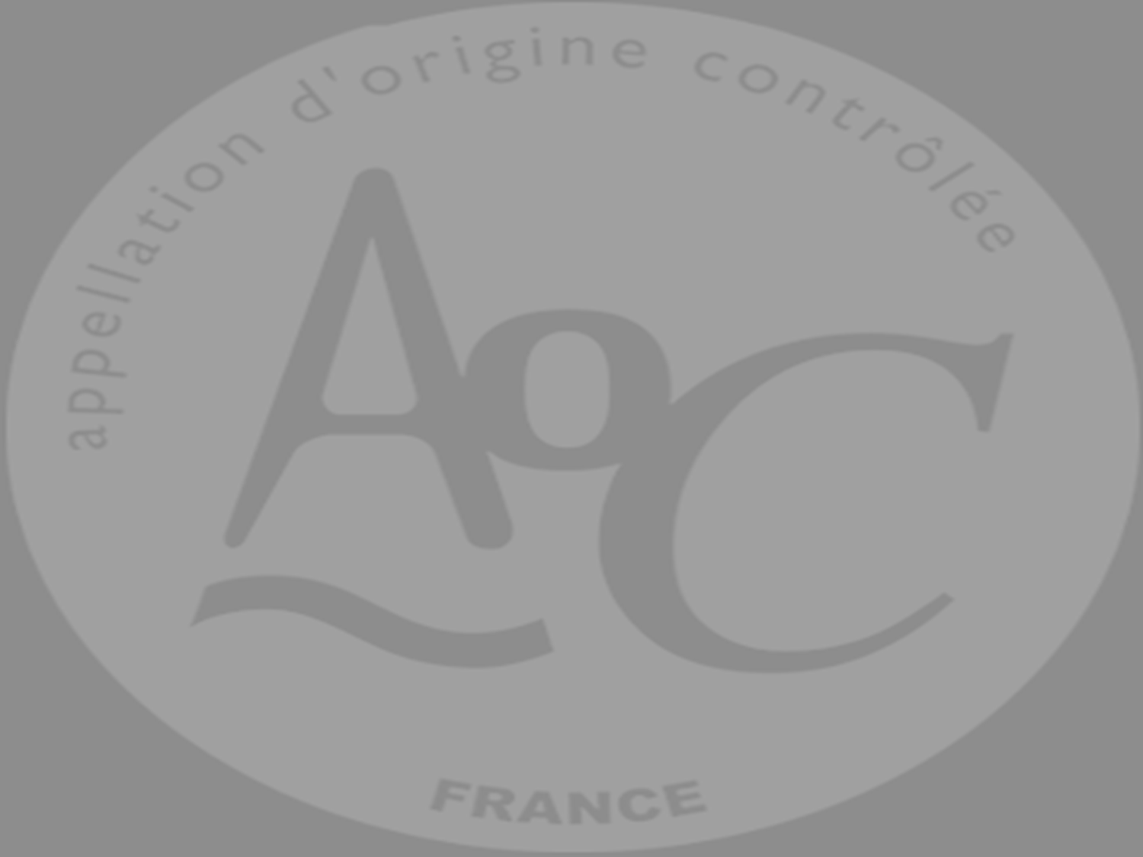
International Protections for Geographic Indications
European Union (TTIP negotiating position fact sheet):
“The protection of geographical indications matters economically and culturally.”
“Create value for local communities through products that are deeply rooted in tradition, culture and geography.”
“Support rural development and promote new job opportunities in production, processing and other related services.”
“Geographical names with commercial value are exposed to misuse and counterfeiting.”
“Abuse of geographical indications limits access to certain markets and undermines consumer loyalty.”
“Fraudulent use of geographical indications hurts both producers and consumers.”

Slide 5
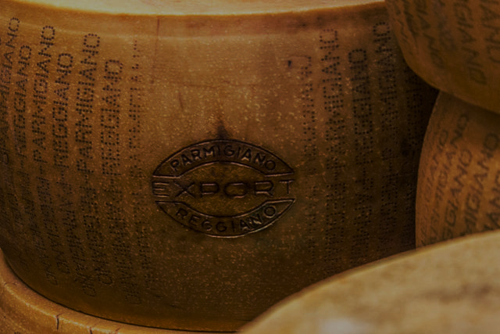
United States (letter from 50 Senators):
“EU has been using its free trade agreements (FTAs) to persuade its trading partners to impose barriers to U.S. exports under the guise of protection for its geographical indications.” . . .
“EU seeks to . . . impair U.S. competition by imposing restrictions on the use of common food names through TTIP.”
Protection of GIs operate as “a barrier to . . . trade and competition.”
EU seeking in TTIP seeking “gratuitous use of GIs as a protectionist measure.”

Slide 6
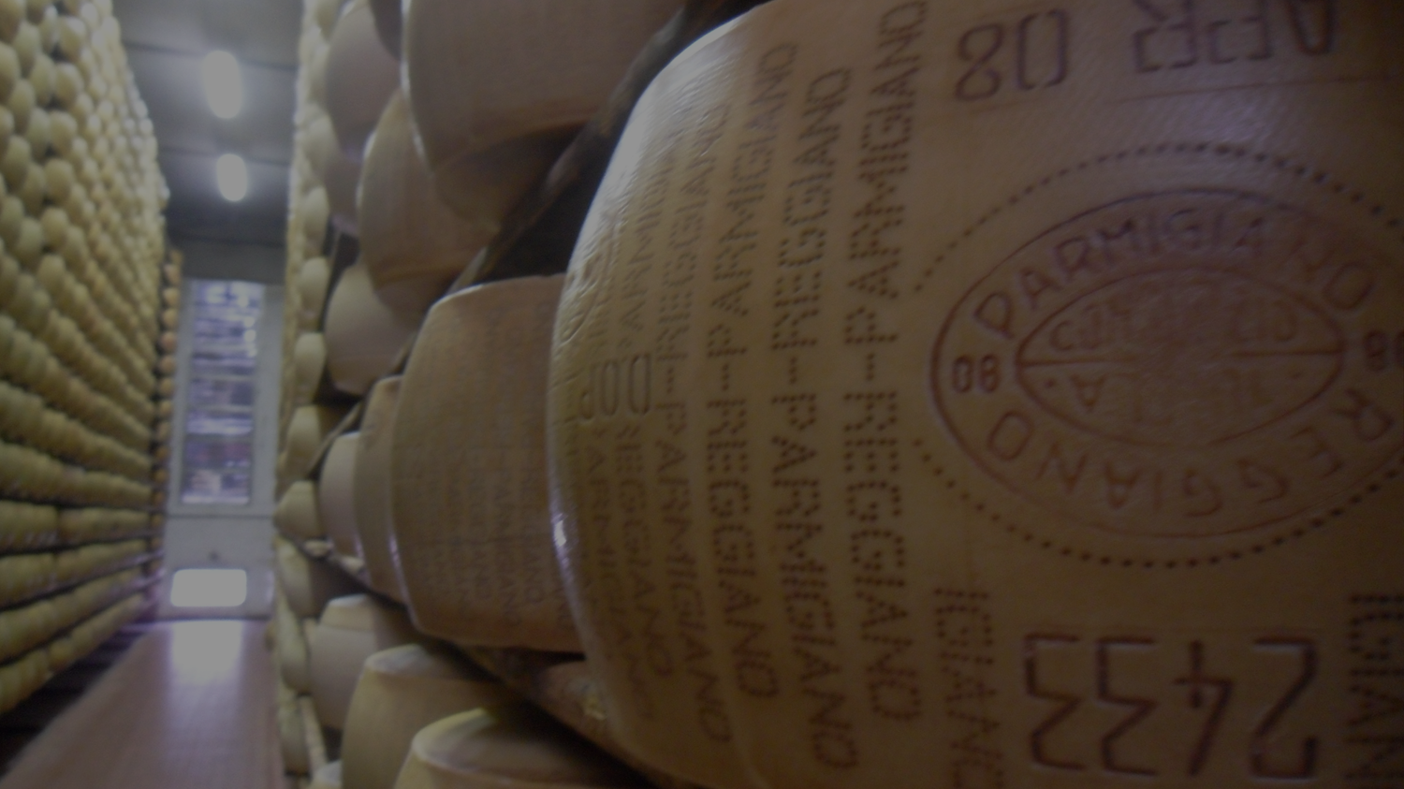
Disparities in domestic regulatory treatment can result in trade disputes:
EU law protects “geographical indications.”
U.S. law allows producers to protect GIs as trademarks.
Nonetheless, many EU GIs are not protected in the United States, and may not be registerable as trademarks because of their widespread generic use.
Products can be sold in the United States which use GIs protected in Europe, but which were not produced in that region.
E.g., “Parmigiano Reggiano” under the EU system, “Parmesan” cheese produced in the United States is regularly sold there.

Slide 7
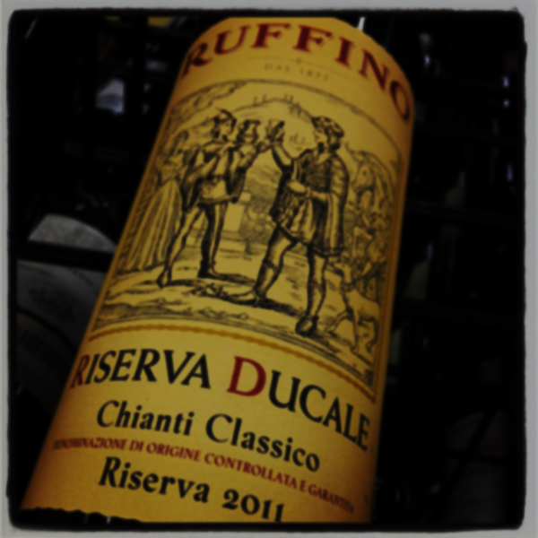
Trade-based theory of intellectual property protection, including GIs (TRIPS)
Unique amongst WTO agreements, establishes affirmative obligations for members to enact identified legal protections for intellectual property.
Reifies intellectual property, such as creative products like motion pictures, by creating goods that can be identified as such in international trade.
Other provisions in trade agreements are typically “negative,” constrain governmental behavior.
TRIPS treats GIs as intellectual property requiring affirmative governmental protection and mutual recognition.

Slide 8
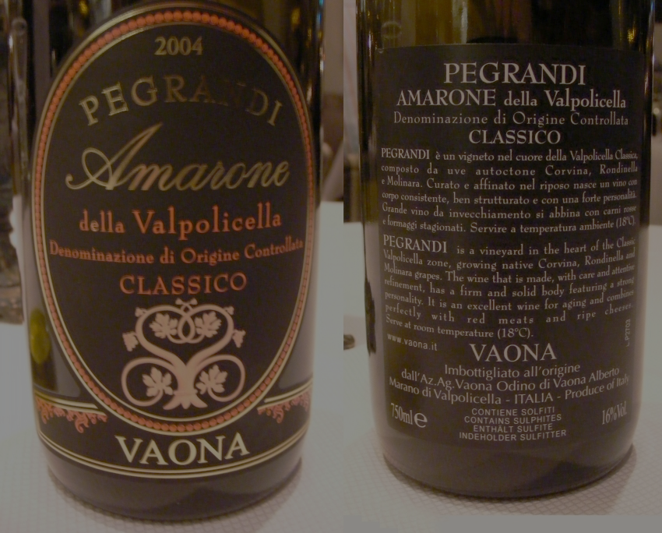
Doha mandate:
Creation of a multilateral register for wines and spirits.
Extension of the higher level of protection found in article 23 beyond wines and spirits to other products as cheeses and dried meats.

Slide 9
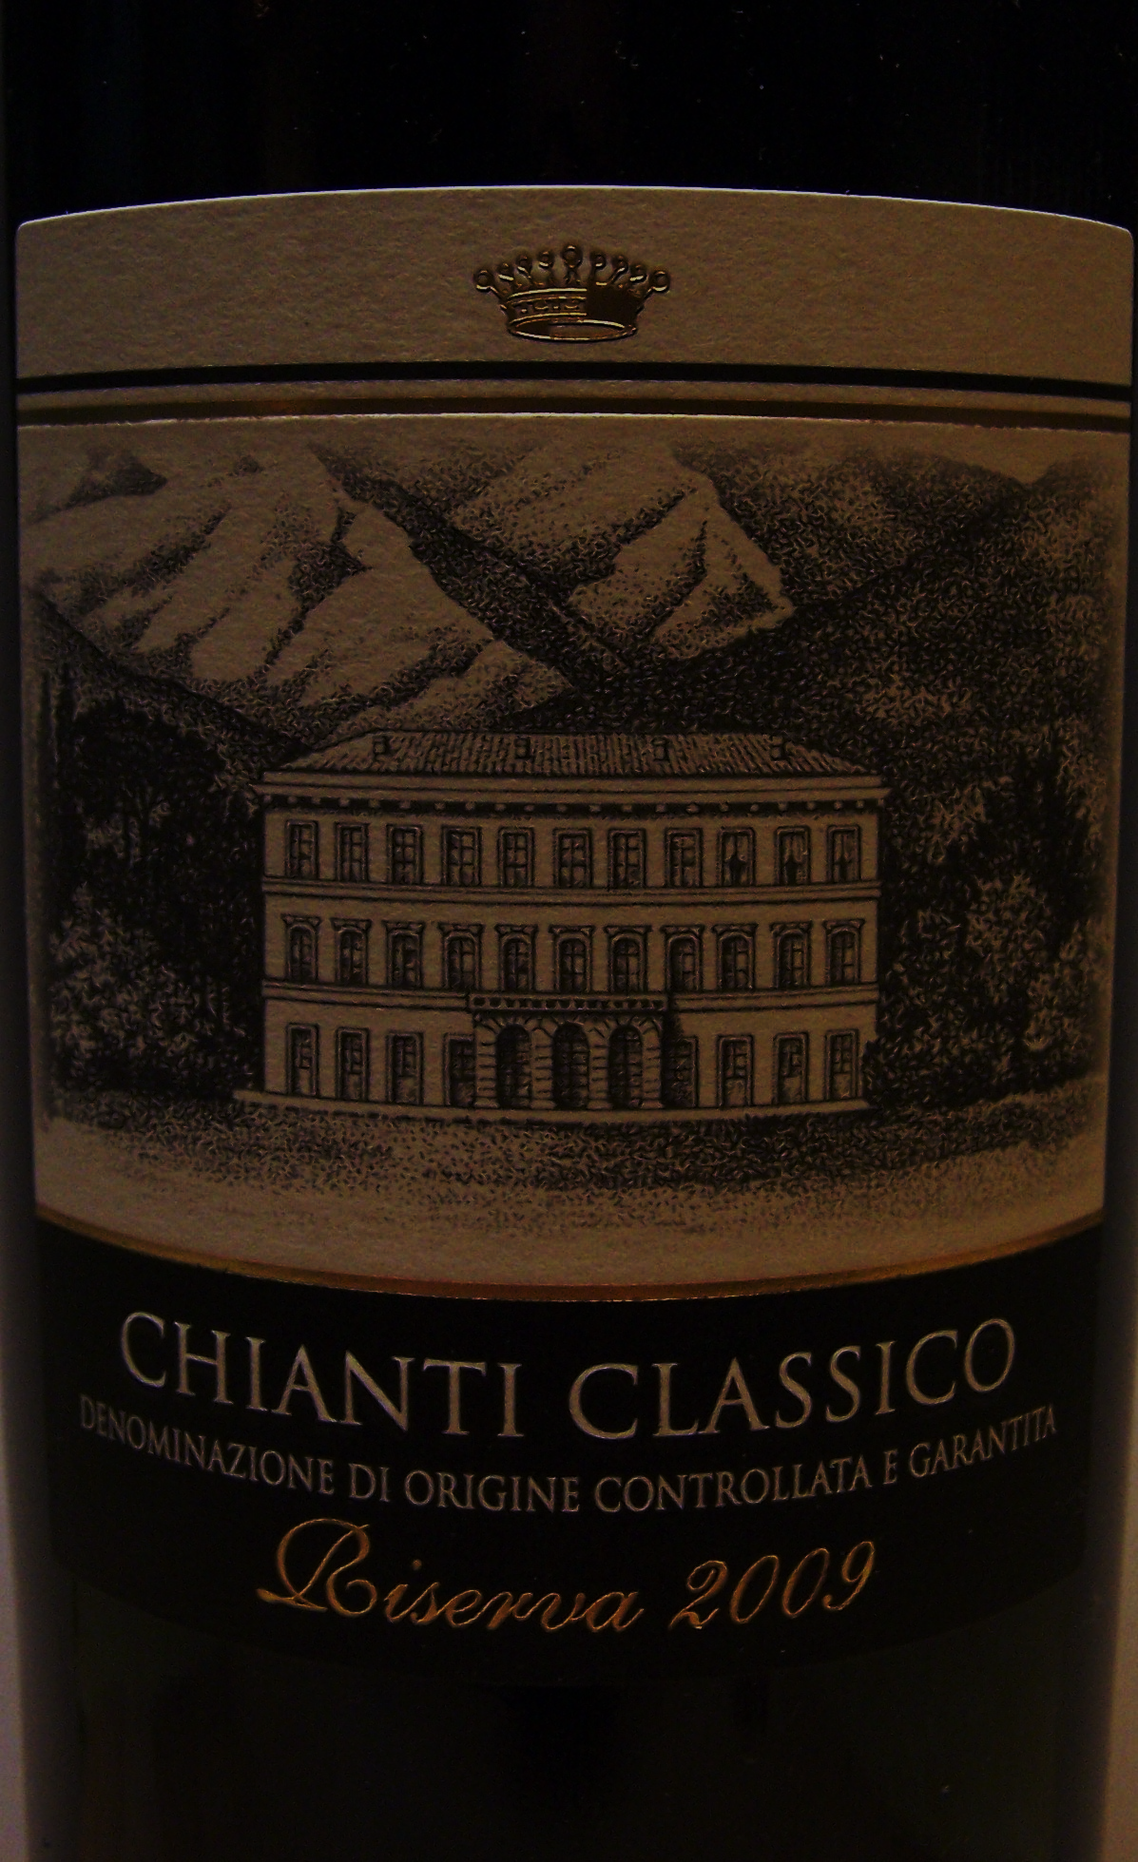
EU goals in TTIP:
“We want the US to improve its system in several important ways.”
“These include: protecting an agreed list of EU GIs, with rules to stop other producers misusing them; [and]
“Enforcing those rules effectively.”

Slide 10
International Standards for Food Safety
GIs no guarantee of safety or of other indications of quality
Laboratory tests conducted on French wines detected residues of an insecticide (bromopropylate) and a fungicide (carbendazim) prohibited in France.
Emmanuel Giboulot, produces organic wines in Burgundy under the appellations “Côte de Beaune” and “Haute Côte de Nuits,” convicted for refusal to spray grapes with pesticides.

Slide 11
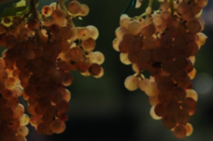
Harmonized International Food Safety Standards
Codex Alimentarius
Intergovernmental
Dual function
Protect health
Promote trade
Nonbinding, advisory
As of 2006:
Evaluated 218 pesticides, establishing 2,930 maximum residue limitations,
Published 1,112 food additive provisions for 292 substances

Slide 12
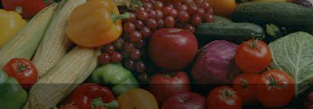
ISO 22000
International federation of standardizing bodies from 163 countries
Not an intergovernmental organization
Work product:
Voluntary standards
Adopted by consensus
Nonbinding, advisory
22000 series “auditable” (subject to verification by accredited private, third-party auditors or certifiers)

Slide 13
Purely private schemes
Global Food Safety Initiative
Global GAP
Concern among developing country exporters about operation as trade barriers, but not disciplined under trade agreements.

Slide 14
Trade-Based Disciplines on Food Safety Standards
Trade agreements concerned with abuse of excessively rigorous standards as trade barriers (negative obligations)
E.g., WTO Agreement on the Application of Sanitary and Phytosanitary Standards
Codex Standards
Transformed from floor to ceiling
Operate as both sword and shield.
Stricter standards subjected to scientific tests
WTO disputes
EU beef hormones
EU biotech

Slide 15
Other International Standards for Labeling of Food
Proliferation of labels, e.g.,
Organically produced;
Sustainably produced;
Natural or all-natural;
GMO-free;
Antibiotic-free;
Hormone-free or no hormones added;
Free-range or cage-free;
Grass-fed or pasture-raised; and
Humane raised and/or handled

Slide 16
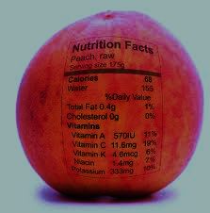
In contrast to food safety standards, little international harmonization
Primarily through Codex:
Nutrition Labeling (mandatory to governmentally-established standards);
Organically produced foods (optional to governmentally-established standards)
GMOs (optional)

Slide 17
Trade-Based Disciplines on Food Labeling
As with food safety, concern is for abuse
E.g., Uruguay Round Agreement on Technical Barriers to Trade
Requires use of “relevant international standards,” e.g., Codex, ISO
Departures allowed, but only when international standard “would be an ineffective or inappropriate means for the fulfilment of the legitimate objectives pursued.”
All labels litigated in WTO held inconsistent with TBT:
EU Sardines (violates Codex standard)
U.S. tuna (violates national treatment standard)
U.S. meat (violates national treatment standard)

Slide 18
Comparison of GIs with food safety and quality labels
Figure 1. Comparison of international legal standards for GIs, food safety standards, and non-GI claims of food quality
 | International Protections for National Measures | Affirmative (Positive) Harmonization | Trade-Based (Negative) Disciplines
GIs | TRIPS TTIP? | No need – international protection for nationally-established GIs in TRIPS | None
Food Safety Standards | Not applicable | Codex (non-binding) ISO (non-governmental, non-binding) Private certifying organizations | WTO SPS Agreement TTIP SPS chapter
Non-GI labeling of quality, sustainability, humane treatment, etc. | Not applicable | Codex (non-binding), but coverage very limited | WTO TBT Agreement TTIP TBT chapter

Slide 19
Conclusion
GIs, a form of label, receive highest level of affirmative protection under TRIPS
GIs not necessarily correlated with food safety (French wines) or other indications of quality (M. Giboulot)
But GIs typically include not just geographical origin but also production methods which are protected
Trade agreements restrict domestic use of food safety and labelling
Trade agreements also restrict use of process and production methods (e.g., TBT tuna labeling dispute)
Only distinguishing feature of GIs is location of production (terroir)
If we give the highest trade-based protection to GIs, then
Maybe food safety standards and other label indications of quality deserve some trade-based measure of affirmative protection and mutual recognition . . .
And, contrary to received wisdom about trade agreements, GIs demonstrate that affirmative protection for food safety standards and other label indications of quality are consistent with structure of trade agreements.

