Slide 1
Rinat R. Gareev
LL.B., LL.M., ACIArb

Slide 3
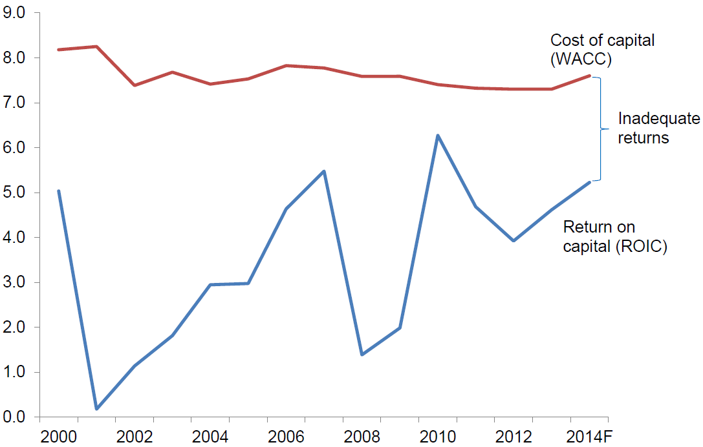
Why Operating Leasing is Growing
Top lessors have lower funding costs and better capital markets access than most airlines
Leasing provides airlines with fleet plan flexibility over time
Lessors are better equipped to manage residual values
Airlines are not covering their cost of capital
Airline Return on Invested Capital vs. WACC
Percent %
Source: IATA.
3

Slide 4
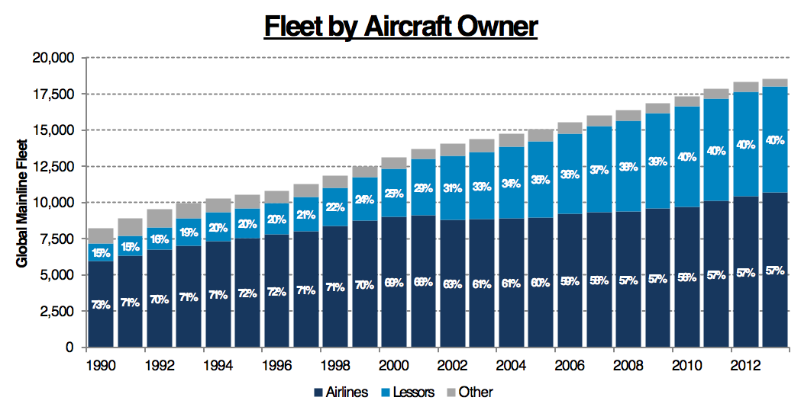
Lessors Account for a Growing Share of Market
Lessors now own 40% of world’s fleet of mainline jets
Number of aircraft owned by lessors increased over 6x since 1990
Lessors responsible for 60% of new incremental aircraft added to world fleet since 1990
Total mainline (>100 seats) fleet grew from 8,200 aircraft in 1990 to 18,500 today
Represents a 4% CAGR
Source: Ascend.
4

Slide 5
Aircraft leasing law:
Contract & personal property law
Cape Town Convention (Aircraft Protocol)
Regulation (EC) 1346/2000 on insolvency proceedings
Key issues: ownership, possession, rights and liabilities re aircraft
Common terminology in aircraft leases:
Dry lease / wet lease
Operating lease
Finance lease
sale – lease back (Sunrock v SAS (2007))

Slide 8
Lessor/Lessee relationship
Key documents
Aircraft lease agreement
Acceptance/ return certificates
Courts’ approach to aircraft leases: Sunrock v SAS (2007)
Faithful reading, business-like interpretation of bargain, common sense
Background knowledge of parties

Slide 9
Areas of dispute
Representations and Warranties
Contractual estoppel
Condition of Aircraft – ACG v Olympic (2013)
Lessee’s internal authorizations & regulatory approvals - Wallis v Air Tanzania (2020)
Return conditions
Events of default
non-payment, unremedied breaches, insolvency, cross-defaults
Repudiatory breach (damages for future loss of profits)

Slide 10
Areas of Dispute
Remedies
Separate remedies: ILFC v Olympus (2020)
Aircraft recovery, damages
Termination of «leasing»
Self help remedies / court orders
Impact of insolvency
Damages
Principles – TWC v Jetline (2020)
Law and jurisdiction clauses / 2 AM clauses (force majeure)

Slide 11
Conflict of Laws
Blue Sky One v. Mahan Air decides that, under English conflict of laws rules, the domestic law of the place where an aircraft was situated on execution of the mortgage determines whether a mortgage over that aircraft was validly created (the lex situs rule).
Blue Sky One decides that, when an English court applies the lex situs rule to an aircraft mortgage's validity:
the English court looks to the domestic law of the situs;
it does not look to the conflicts rules of the situs;
there is no return to sender.

Slide 14
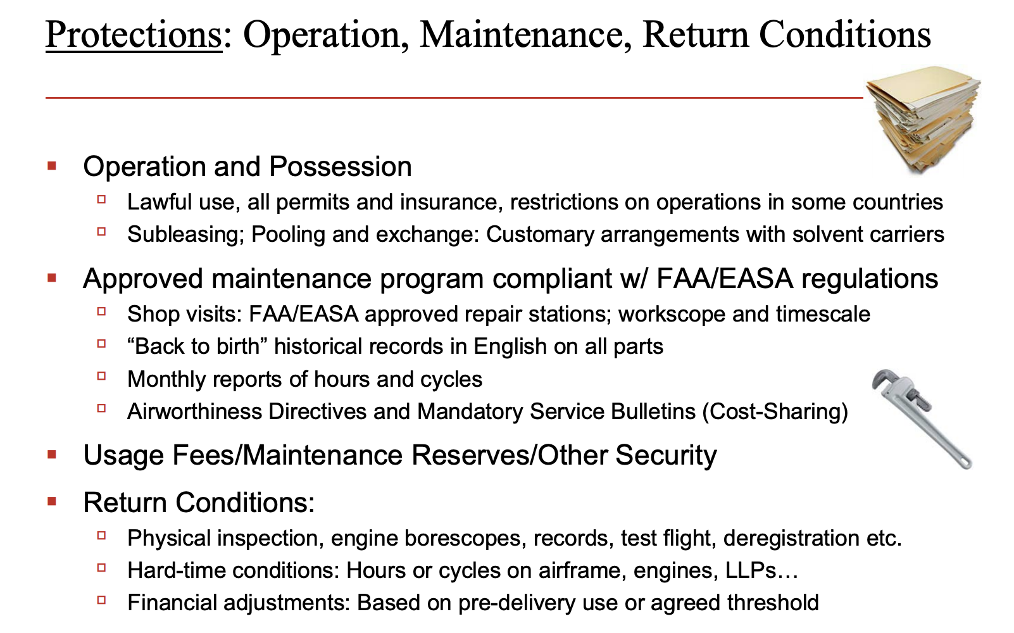

Slide 15
Lease Documentation – Basic Principles
Protect the pricing
Cash flows
Rents
Maintenance payments / contributions
Residual value
Ongoing maintenance, registration, compliance covenants
Condition of the aircraft at return
Protect ‘triple-net’ nature of the lease
Tax representations and indemnities
Insurance covenants
Disclaimer / General indemnity
Guard against the unknown (and prepare for the worst)
Representations and warranties
Unconditional Acceptance by Lessee [ACG Case – what does this really mean?]
Disclaimer / Waiver of all Warranties
Credit risk – deposits, credit support and financial reporting
Events of default / Remedies
Indemnities
Choice of Law / Choice of Jurisdiction
15

Slide 16
Lease of Aircraft
Delivery Procedures
Conditions to closing
Lessee’s right to reject
Lessee’s / Lessor’s right to walk
ACG Form:
4.2 Delivery
Delivery Condition: Lessor shall deliver the Leased Property "as is, where is" and in the condition required in Schedule 2, except for any items set forth on Annex 2 to the Certificate of Acceptance and any other items agreed in writing by Lessor and Lessee.
AYR Form (Ryan International):
2.1 Delivery Lessor hereby agrees to deliver the Aircraft to Lessee at the Delivery Location and to lease the Aircraft to Lessee, and Lessee hereby agrees to accept the Aircraft at the Delivery Location and to lease the Aircraft from Lessor, in each case, on the Scheduled Delivery Date and in the Delivery Condition, subject to the satisfaction or waiver of the conditions precedent set out in Schedule 7 and Schedule 8 and otherwise subject to the terms and conditions of the Operative Documents. Lessee shall execute and deliver the Acceptance Certificate to Lessor on the Delivery Date. The delivery requirements and delivery procedures are more fully set out in Schedule 3
See Also – Part II of Schedule 3 to the Ryan Lease
Conditions Precedent
16

Slide 17
Delivery Procedures – Ryan International
1.2 Discrepancies
Any discrepancy from the condition of the Aircraft as described in Part 1 of Schedule 3 which is identified in writing to Lessor by Lessee on or prior to the Scheduled Delivery Date (or during the flight test procedures pursuant to Section 1.1 of this Part II of Schedule 3) and which is not corrected by Lessor on or prior to the Delivery Date shall be corrected by Lessee or its designee and Lessor shall reimburse Lessee at 100% of Lessee's reasonable actual cost for such correction, payable on demand (together with detailed and substantiated labor and material invoices for all such amounts for which reimbursement is sought). Lessee’s right to make such a claim for reimbursement shall be Lessee’s sole remedy for noncompliance, and Lessee shall not have the right to refuse acceptance of the Aircraft because of such discrepancies unless the existence of such discrepancies would prevent the issuance on the Delivery Date of an airworthiness certificate, in which event Lessor and Lessee shall negotiate in good faith a fair and equitable procedure by which such discrepancies shall be corrected and the Delivery Date shall be delayed until such discrepancies are corrected, subject to Section 2 of this Part II.
Delivery Conditions
ACG: “be airworthy, conform to type design and be in a condition for safe operation….”
Ryan International: “…have and be in compliance with an Airworthiness Certificate….”
Drafting style: Your client’s obligations, or the conditions precedent it must meet, should be narrowly drafted with objective criteria to judge compliance, and any exceptions should be broadly cast if possible
17

Slide 18
Lease of Aircraft (Continued)
Lease term / return of aircraft
Detailed return conditions
Critical to preserving the residual value of the aircraft
Rent
Security Deposit
Cash vs. Letter of Credit
Disclaimer
ACG Form
THE AIRCRAFT IS ACCEPTED BY LESSEE "AS IS, WHERE IS " AND LESSEE AGREES AND ACKNOWLEDGES THAT, SAVE AS IS EXPRESSLY STATED IN THIS AGREEMENT, LESSOR WILL HAVE NO LIABILITY IN RELATION TO, AND LESSOR HAS NOT AND WILL NOT BE DEEMED TO HAVE MADE OR GIVEN, ANY CONDITIONS, WARRANTIES OR REPRESENTATIONS, EXPRESS OR IMPLIED, WITH RESPECT TO THE AIRCRAFT, INCLUDING….
AYR Form (Ryan International)
EFFECTIVE UPON ACCEPTANCE OF THE AIRCRAFT BY LESSEE, WHICH SHALL BE EVIDENCED BY DELIVERY OF THE AIRCRAFT TO LESSEE, THE AIRCRAFT SHALL BE LEASED UNDER THE LEASE AGREEMENT “AS-IS, WHERE-IS, WITH ALL FAULTS” AND LESSEE AGREES, ACKNOWLEDGES AND ACCEPTS THAT NO INDEMNIFIED PARTY MAKES ANY WARRANTY OR REPRESENTATION WHATSOEVER CONCERNING THE AIRCRAFT…. LESSEE… HEREBY WAIVES, RELEASES AND RENOUNCES ALL WARRANTIES, REPRESENTATIONS AND OTHER INDEMNITIES, GUARANTIES, OBLIGATIONS AND LIABILITIES …. EXPRESS OR IMPLIED, ARISING BY LAW OR OTHERWISE……WITH RESPECT TO THE AIRCRAFT….INCLUDING….
18

Slide 19
Short-Term Emergency Engine Lease – User Guide
“In relation to [the delivery procedures / delivery conditions], before accepting the Engine Package Lessee may satisfy itself that the Engine Package meets any specified delivery conditions, including the technical conditions in Clause 2.3.1. If the Engine Package fails to satisfy these specified conditions, Lessee may decide not to accept the Engine and the term will not commence. It is important to note that Lessor makes no representation or warranty regarding the condition of the Engine Package, and any specified delivery conditions will not constitute representations or warranties by Lessor that have relevance after acceptance by Lessee of the Engine Package.”
(Joint project between the Aviation Working Group and the International Air Transport Association)
19

Slide 20
Representations and warranties
Establishing very basic principles on which the transaction is based
Many of these will be backed up by legal opinions
General Covenants
From Lessor
Right of Quiet Enjoyment
From Lessee
Reporting, no liens, etc.
Title/Registration/Filings
Cape Town
Possession
Subleasing vs. Wet Leasing
General Indemnity
Scope - Lessor seeks broad scope / Lessee seeks narrow scope
Exclusions - Opposite holds true
Contest rights
20

Slide 21
Tax Indemnity
Risk of Loss
Damage
Repair/replace
Loss of value?
Total Loss
Payment of agreed value
Insurance
Casualty – damage to or loss of leased aircraft
Liability – damage to or loss of other property or injury/loss of life
Basic structure of lessee insurance: ‘all risks’ vs. war risks / protective endorsements
Lessor liability topics – recent Florida case (Vreeland v. Ferrer)
Events of Default
Lessee performance
Lessee credit
Remedies
Repossession – termination, self-help and other topics
Damages
Section 1110 / Cape Town remedies
21

Slide 22
Miscellaneous Provisions
Lessor transfers – financings / sales
Governing Law / Jurisdiction
Alternative Dispute Resolution?
Exclusive jurisdiction?
Operational Matters
Maintenance, operation and related topics
Operation in violation of law
Maintenance Payments
Return / Redelivery Procedures and Return Conditions
Inspections
Records
Technical condition
22

Slide 23
ACG Acquisition v. Olympic

Slide 24
ACG Acquisition v. Olympic
Discussion Points
Intent of the parties
A remarkable bargain?
Condition of the aircraft at delivery
Important or not?
Airworthy vs. Seaworthy?
Lessor’s obligation to deliver the aircraft in compliance with the delivery conditions
A covenant? What was the remedy for breach?
How did the Acceptance Certificate help the lessor?
Why would a lessor be reluctant to take on full responsibility for delivery in the agreed condition?
Appellate opinion
Which lease provisions were most important and persuasive?
24

Slide 25
Discussion Question 1a The Summary Judgment opinion rightly points out that this is an extreme case. Why does the Summary Judgment opinion feel ACG’s explanation of the position of the parties would be a “remarkable bargain”?
It’s a “remarkable bargain” because ACG believes 4.2(a) and the other provisions in the lease regarding the certificates as a disclaimer to prevent any claim for breach of contract, which is unreasonable and uncommercial.
Issue of Allocation of Risk

Slide 26
Discussion Question 1a cont. The Summary Judgment opinion rightly points out that this is an extreme case. Why does the Summary Judgment opinion feel ACG’s explanation of the position of the parties would be a “remarkable bargain”?
The judgement (2010) contended:
The parties of contract can make a bargain, but it would be unfair and meaningless if: It unreasonably deprived a party’s fundamental rights in transaction.
The judge’s conclusion is:
“The effect of the acceptance of the aircraft is limited to the right of rejection and does not extend to the right to claim damages, still less to claim total failure of consideration.”

Slide 27
Discussion Question 1b Does the appellate judge seem share this view? Why or why not?
“[C]omplexity of a modern passenger aircraft is such that . . . parties to leases such as this could face years of uncertainty as to the allocation of responsibility for defects of which neither of them were aware on delivery . . . . it is commonplace for parties in this market to contract . . . appears to be intended to provide a structure whereby a lessee elects whether or not to accept an aircraft on lease and with it the risk of non-compliance with required delivery condition becoming apparent later.” ¶42, 2013 Judgment

Slide 28
Discussion Question 1b cont. Does the appellate judge seem share this view? Why or why not?
“[I]t is impossible to inspect an aircraft fully and therefore correspondingly impossible to eliminate the risk of undiscovered defects upon delivery. . . . parties know that neither can be absolutely certain of an aircraft’s condition at the point at which the lessee is called upon to accept delivery and the on-going risk. That commercial parties should in such a situation strive to achieve finality in relation to the allocation of risk and responsibility is a commonplace.” ¶43, 2013 Judgment

Slide 29
Discussion Question 2a The trial judge focused a lot of attention on the specific defects in the aircraft, and on whether these might have existed at delivery to Olympic or might have arisen later. The trial judge also devoted a great deal of effort to considering the meaning of “airworthy” – one of the delivery conditions from Schedule 2 Why does the appellate judge appear fairly unconcerned about these issues?
The appellate judges mostly deferred factual determination to trial judge
The actual defect was so severe that regardless of applicable legal definition of “airworthiness”, the airplane was most likely not airworthy.
However, the actual defects are not relevant to the claim based on estoppel theory, the true dispositive issue the appellate judge found.

Slide 30
Discussion Question 2b What do you make of the trial judge’s analogy to “seaworthy”? How did the appellate judge feel about that?
It was a reasonable approach but not necessarily sound. Aviation is significantly different from naval navigation.
Aviation industry is distinguishable from others equipment leasing industries because of following factors
Expectations of the parties
Assignment of risk
Nature of non-operating owner-lessor in aviation

Slide 31
Discussion Question 3a Both the trial judge and the Summary Judgment opinion put a great deal of emphasis on the lessor’s breach of its covenant to deliver the aircraft in the condition specified in the lease. Why was that considered important?
ACG fundamentally failed to perform its obligations in relation to the delivery condition of the aircraft. (clause 4 and schedule 2, Para. 10 and 11)
Olympic was able to carry out external inspections but the scope was limited. (Para. 20)

Slide 32
Discussion Question 3a Both the trial judge and the Summary Judgment opinion put a great deal of emphasis on the lessor’s breach of its covenant to deliver the aircraft in the condition specified in the lease. Why was that considered important?
Regardless of their breach, Olympic are precluded by their acceptance of the aircraft from maintaining any claim. (Para. 33)
Court turned this down conclusive proof argument and said clause 7.9 does not waive any right the lessee may have. (highlighted in notes)
However, ACG ends up prevailing under the doctrine of equitable estoppel. (highlighted in notes).

Slide 33
Discussion Question 3b Do you think the drafting of 4.2(a) contributes to the confusion, and if so, why? Did the Acceptance Certificate “fix” the problem (perhaps) from the perspective of the lessor?
4.2 Delivery Condition: Lessor shall deliver the Leased Property “as is, where is” and in the condition required in Schedule 2
ACG argued “the aircraft and aircraft documents are satisfactory to the lessee”
Olympic stated in the Certificate of Acceptance that the aircraft “complied in all respects with the condition required at delivery under section 4.2 and Schedule 2.”
Olympic argued against contractual estoppel
Etsoppel only applied in so far as the lessee had been able to form a meaningful view based on its limited inspection and on the assumption that the aircraft and documents had been tendered in compliance with Schedule 2 of the lease.
The fact that Olympic accepted the aircraft does not in any way disable it from obtaining damages in respect of a breach of clause 4.2(a).

Slide 34
Discussion Question 3c Why would a lessor be reluctant to agree to an unconditional obligation to deliver an aircraft in a particular condition? Did you see anything in the opinions that demonstrated how ACG approached the transition from Air Asia to Olympic?
ACG employed the services of Aircraft Engineering & Consulting Limited (AEC) to assist it with the redelivery of the aircraft from AirAsia and the delivery of the aircraft to Olympic in Singapore.
AEC produced an Inspection Discrepancy List following an inspection of the aircraft.

Slide 35
Discussion Question 3c cont. Why would a lessor be reluctant to agree to an unconditional obligation to deliver an aircraft in a particular condition? Did you see anything in the opinions that demonstrated how ACG approached the transition from Air Asia to Olympic?
Photographs were taken to illustrate the discrepancies noted.
“ACG is typical of aircraft lessors in not being an operator of aircraft. A lessor’s role is essentially financial – to raise finance on the strength of which aircraft can be acquired and leased out. A lessor does not typically undertake maintenance of its aircraft.” ¶ 41, 2013 Judgment

Slide 36
Discussion Question 4 What lease provisions / other documents did the appellate judge find most important and persuasive? Why?
The interaction between § 4.2, § 7.9, Schedule 2 and the Certificate of acceptance is critical to the outcome of the case
4.2(b): lessee entitled to observe various specific technical inspections and tests.
4.2(f): lessee is entitled to note discrepancies on Annex 2 to the Certificate of Acceptance and to require their correction failing which the lease may be terminated
Schedule 2: yardstick to measure the lessee's satisfaction with the aircraft
Lessee entitled to inspect the aircraft throughout the C check and to require the rectification of any defects.
7.9: delivery by lessee to lessor of a certificate will be conclusive proof that the aircraft and the aircraft documents are satisfactory to the lessee.

Slide 37
Discussion Question 4 What lease provisions / other documents did the appellate judge find most important and persuasive? Why?
“The combined effect of clause 7.9 and the Certificate of Acceptance is that the lessor is conclusively agreed to have satisfied both its positive obligation to deliver the aircraft in a condition compliant with Schedule 2 and the condition precedent providing that the lessee is not required to accept the aircraft unless it is in the condition required by clause 4.2(a) and Schedule 2”
¶52, 2013 Judgment

Slide 38
Takeaways from the Olympic Case
There is a de facto duty to certify at delivery;
A potential legal claim (or a potential mechanism built in the contract) against the prior user for improper maintenance;
Fallacy of poor management or cash drought?

